Slide 1
Thesis defense
Arangamanikkannan Manickam
Dept. of Computer Science
University of West Florida
Dr. Thomas Reichherzer
Dr. Sukumar Kamalasadan
Dr. Sharon Simmons

Slide 2
Table of contents
Part I: Review of proposal
Introduction
Proposed Intelligent Multi-agent systems architecture
Architecture wide area controller
Research scope and objectives
Part II: Design
Multi-agent system design
Ontology design
Wide area controller design
Part III: Testing and Results
Multi-agent system testing
Testing with a single cluster
Collaborative cluster testing
Wide area controller testing
Training the neural networks
Torque disturbance testing
Fault analysis testing

Slide 3
Part I Review of proposal

Slide 4
Introduction
Multi-agent systems create a collaborative framework for distributed problem solving.
Modern complex systems are highly sophisticated in both hardware and software components.
Artificial intelligence based tools help controlling these dynamically changing complex systems with high resolution.
Adaptive critic designs for neuro-control is suitable for learning in noisy, nonlinear, and non-stationary environments.
One such complex system is a power system used in this research study.

Slide 5
Challenges in complex systems control and protection
Complex systems require continuous monitoring and immediate fault restoration.
Monitoring components are software modules require periodic communication between other monitors in the system.
The communication is done through the Internet which is vulnerable to cyber attacks.
During severe disturbances or contingencies, local controllers used to control the system components doesn’t guarantee stability.

Slide 6
Proposed solution
What is needed?
Continuous monitoring of system components and immediate fault restoration.
Coordination and security in monitoring components.
Performing wide area controlling with a global level knowledge.
Solution:
FIPA-compliant and multi-agent systems are developed for monitors and supervisors.
Use mutation principle to secure the agents.
‘Monitors’ perform continuous monitoring of power system components and ‘Supervisors’ coordinate the activities of monitors and also protect system components.
Wide area monitoring is done by the supervisor using intelligent algorithms based on neural network based designs

Slide 7
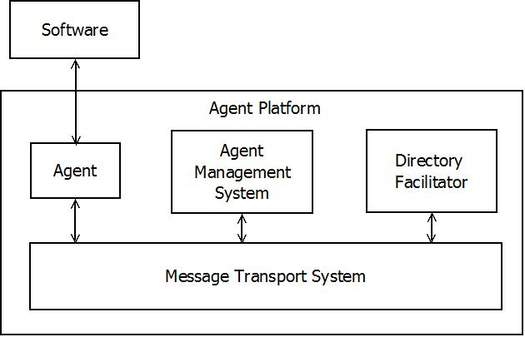
FIPA-compliant secured multi-agent systems
FIPA is an IEEE computer society promoting agent based technology and interoperability of its standards.
Divided into five categories
Applications
Abstract architecture
Agent communication
Agent management
Agent message transport
FIPA – Foundation for Intelligent
Physical Agents.

Slide 8
Research scope and objectives
This research is focused mainly on developing self-secure and intelligent multi-agent systems capable of performing wide area controlling.
Design and develop a FIPA-compliant multi-agent system for monitors and supervisors from self-secured fault tolerant multi-agent system based on mutation.
Develop an ontology for the developed multi-agent system to converse with each other.
Develop wide area controller using adaptive critic designs for stabilizing components in the power system.
Formulate test cases and measure the performance of developed architecture and compare it with other available solutions.

Slide 9
Design steps in multi-agent system with embedded wide area controller
Design FIPA-compliant multi-agent system
Design an ontology suitable for communicating power system related information.
Design clusters of agents to perform monitoring and supervision activities.
Implement this agent system and test with multi-machine power system.
Design wide area controller using adaptive critic designs.
Test the controller in a complex multi-machine power system, measure the system performance, and compare the results with local controllers.

Slide 10
Part II Design

Slide 11
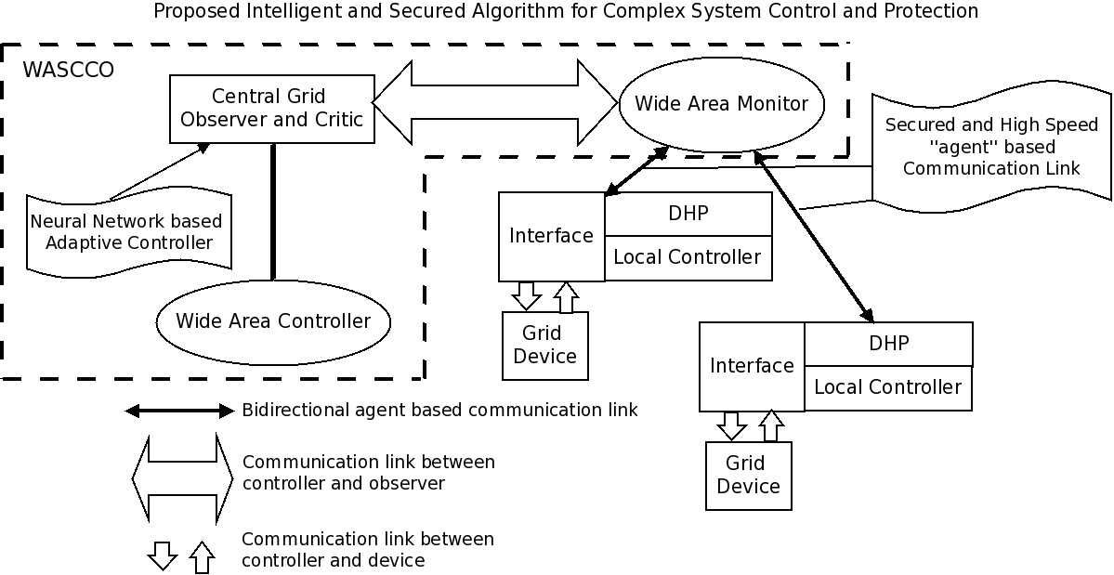
Proposed design
2
1

Slide 12
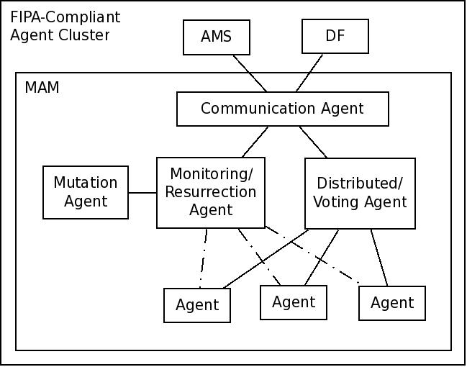
Multi-agent system design
control
data

Slide 13
Special purpose agents
Special purpose agents: Agent Management Service (AMS) and Directory Facilitator (DF).
Helps in inter-agent collaboration.
AMS: Holds a database of agent configuration and respond to queries by other agents.
-DF: Maintains a list of services provided by the agents and responds to queries asked by other agents.
control
data

Slide 14
General purpose agents
General purpose agents:
provides security services.
Performs monitoring/supervision activities.
control
data

Slide 15
Communication agent
Communication agent (CA):
Communication endpoint for messages sent/received with outside world.
Routes messages to the intended agent within the MAM.
Additional functionalities:
Knowledge Exchange
Fault reporting
control
data

Slide 16
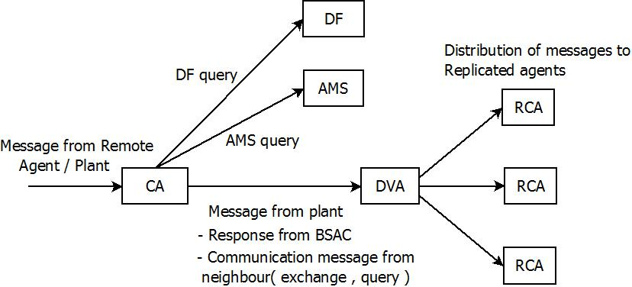
Communication agent – message routing

Slide 17
Monitoring/Resurrection agent
Monitoring/Resurrection Agent (MRA):
Core module of the MAM.
Continuous monitoring of all agent modules in the MAM.
Performs agent resurrection in following cases:
Incorrect response from agent
Delay in receiving a response
Reception of a faulty response
control
data

Slide 18
Distributed/Voting Agent
Distributed/Voting agent (DVA):
It acts as the leader of all replicated agents.
It serves three main purposes.
Data distribution to replicated agents.
Voting of agent responses.
Reporting about non-responsive agents to monitoring/resurrection agent.
control
data

Slide 19
Mutation agent
Mutation agent (MA):
It runs on a command from MRA.
Mutates the agent source code returns this compilation to MRA.
MRA loads this to memory.
Agent modules are mutated initially during system boot and also during resurrection.
control
data

Slide 20
Replicated computational agents
Replicated computational agents (RCA):
Actual functional part of MAM.
Performs monitoring/supervision activities.
Analyze the power system with the parameters received and perform activities to protect the system
Restore faults immediately by agent-collaboration.
control
data

Slide 21
Agent cluster design
Agent clusters are placed on all nodes in the power system.
Clusters are classified into two types.
Bus Management Agent Clusters or Monitors (BMAC): placed near generating stations.
Monitors the components of power node.
Reports abnormal activity to the supervisor.
Bus Supervision Agent Clusters or supervisors (BSAC): placed in each area to coordinate the activities of ‘group of monitors’
Restores fault upon receiving report from monitors.
Performs wide area monitoring.

Slide 22
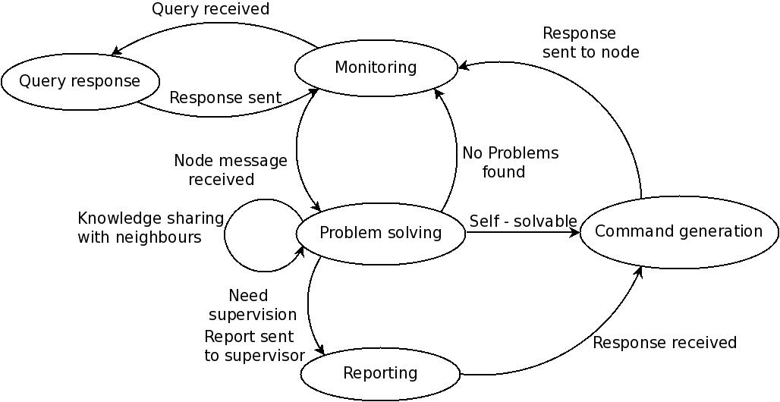
Activities of monitor

Slide 23
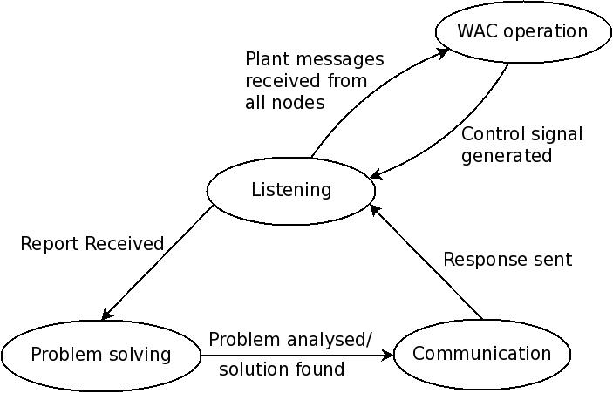
Activities of supervisor

Slide 24
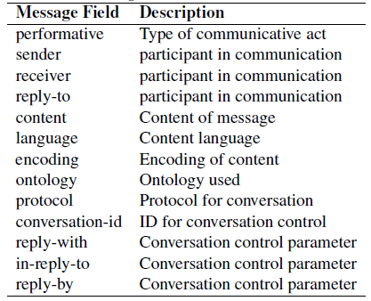
Communication between agent clusters
Communication between agent clusters help the problem to be solved faster and efficiently.
Agent Communication Language (ACL): language used for communication.
Message content comprises two parts.
Content language
Ontology.
FIPA ACL Message structure

Slide 25
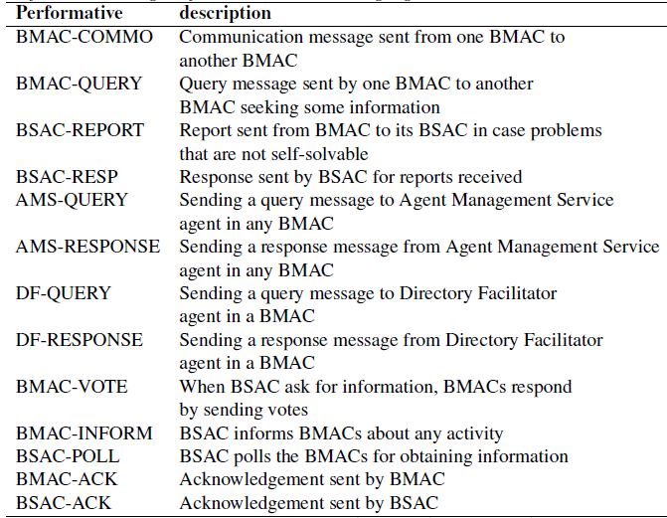
Performatives designed for MAS-PS
Multi-Agent Systems – Power Systems (MAS-PS)
Customized content language based on FIPA-ACL is used in this agent model to fit our needs.
Agent understands the activity needs to be taken based on the performative.

Slide 26
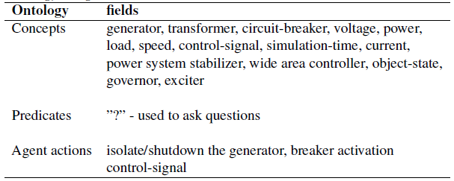
Ontology design

Slide 27
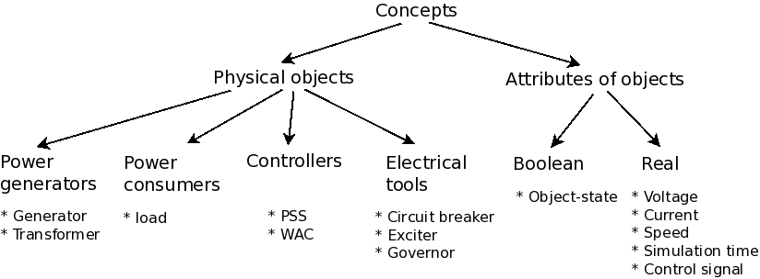
Concepts – a hierarchical model

Slide 28
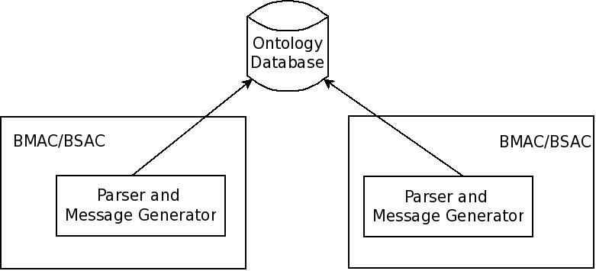
Ontology Implementation in agent clusters
Parser – decode incoming message.
Message generator – generate outgoing message following the structure and ontology.

Slide 29
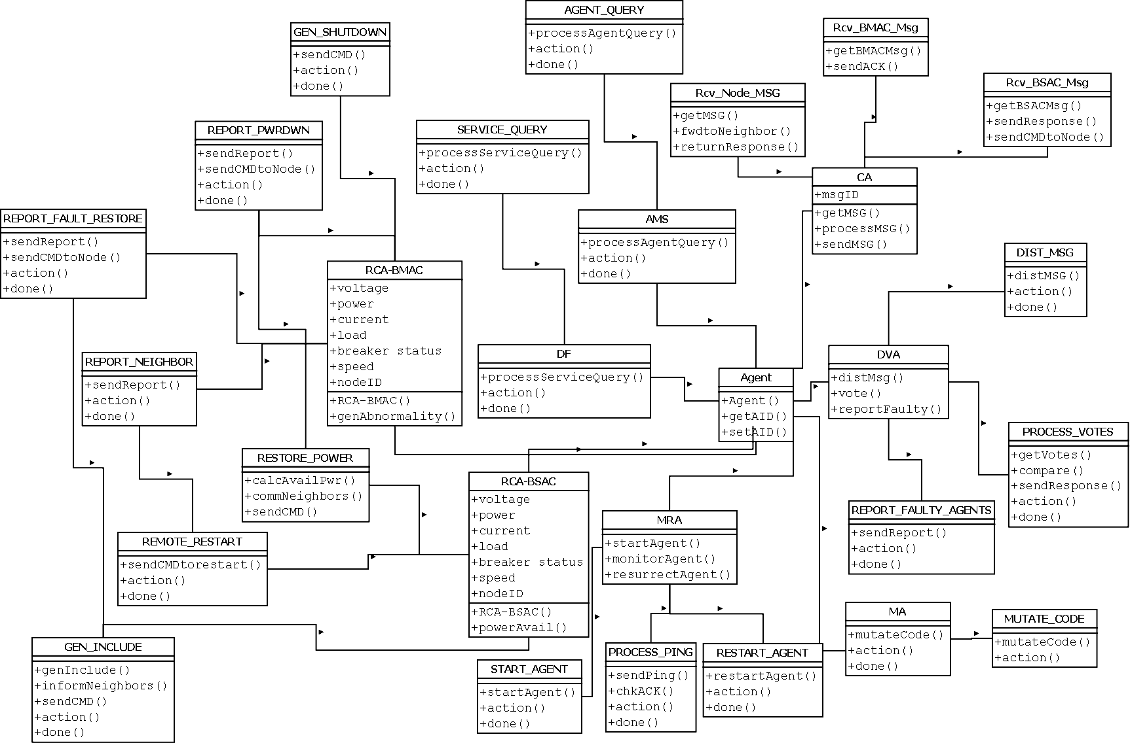
UML diagram of the entire agent system model

Slide 30
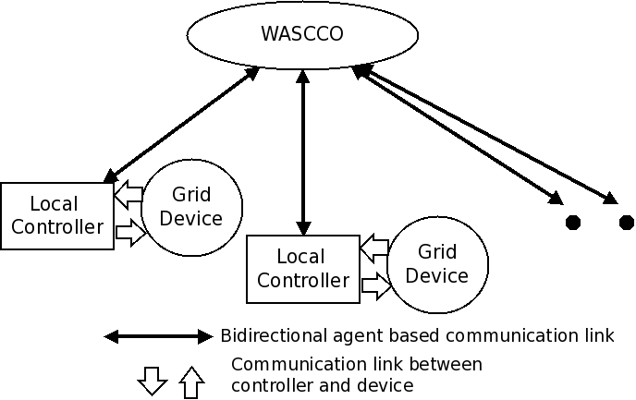
Wide area coordinating system centric controller and observer
WASCCO is connected to different types of grid devices.
Interacts with the local controller to maintain the stability of the system.

Slide 31
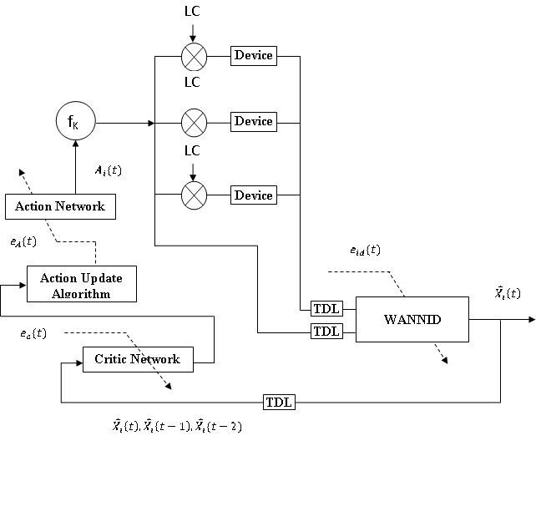
Controller design
WANNID – Model neural network identifier to predict the next state.
Action network – Uses the predicted plant inputs to generate a control signal.
Critic neural network – used for training the action neural network online.
The control signal is used with local controller to control the device.

Slide 32
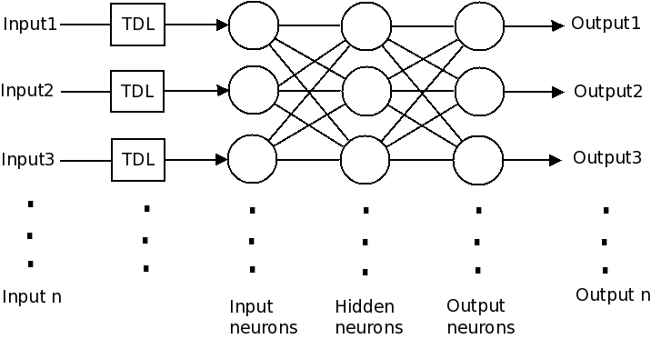
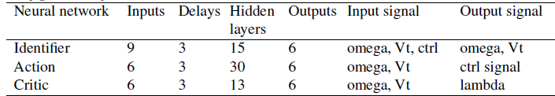
Interconnections of a neural network and configuration

Slide 33
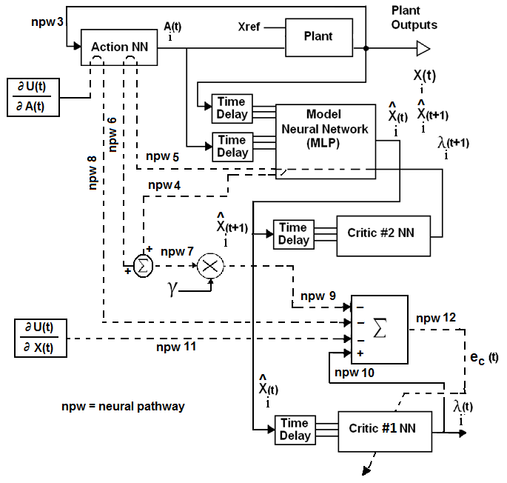
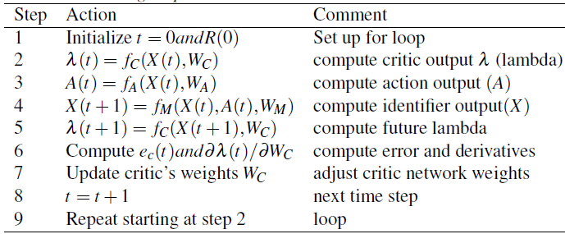
Critic adaptation and training steps

Slide 34
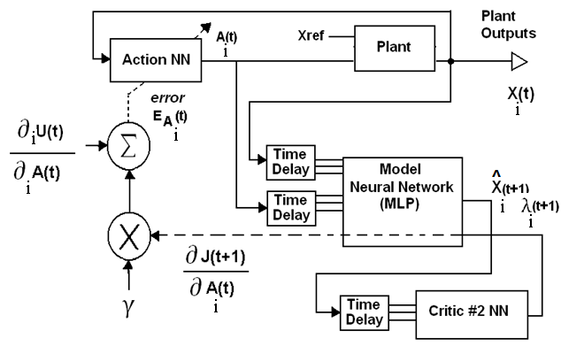
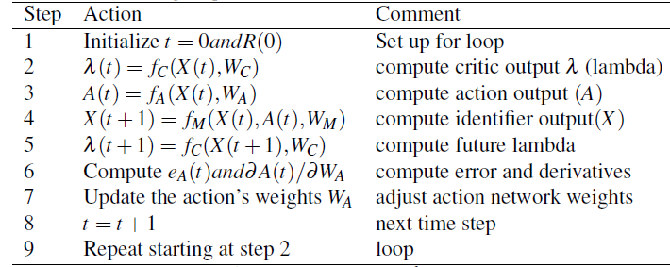
Action adaptation and training steps

Slide 35
Wide area controller training
Train the model neural network offline and online to better predict the future state of the plant.
Train the action offline to act like Power System Stabilizer (PSS).
Train the action network online using critic neural network.
Develop test cases to test the functionality of the controller
Torque disturbance test case
Short circuit fault test case.

Slide 36
Part III Testing & Results

Slide 37
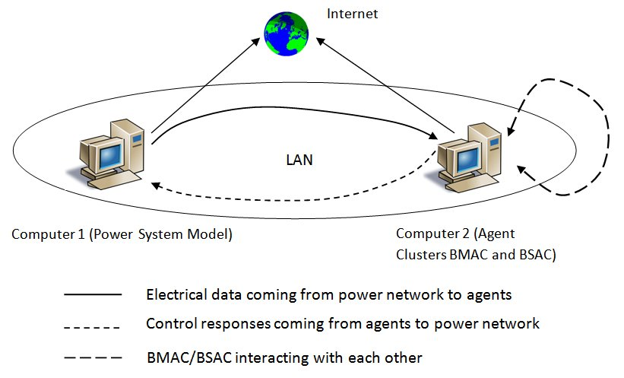
Experimental setup
Computer 1 (windows)
Power system model is implemented in PSCAD with MATLAB interface for controller implementation and communication link
Computer 2 (linux)
Multi-agent system is implemented in ANSI C.
Communication is done through Local Area Network (LAN) using User Datagram Protocol (UDP).

Slide 38
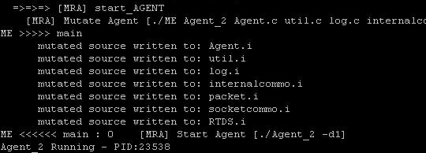
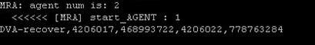
Testing mutation
Agent killed
New mutant
resurrected
DVA recovered

Slide 39
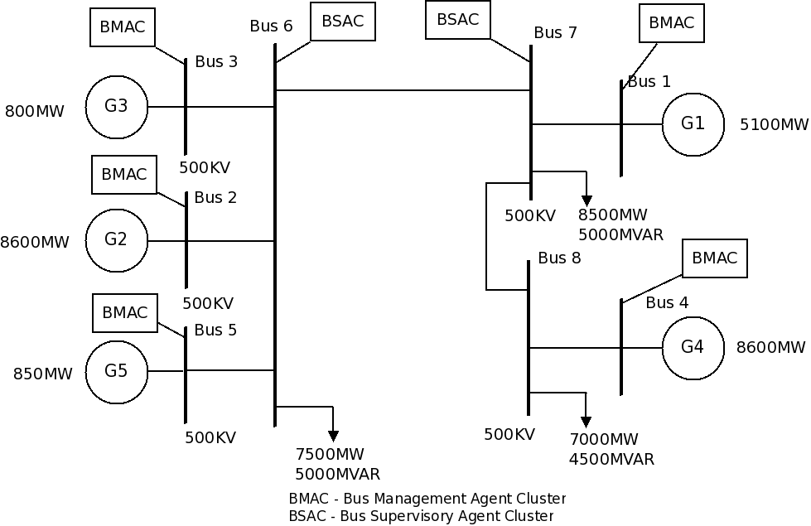
Two-area power system model for agent cluster testing
Area 1 → G3, G2, and G5
Area 2 → G1 and G4.
Area 2
Area 1

Slide 40
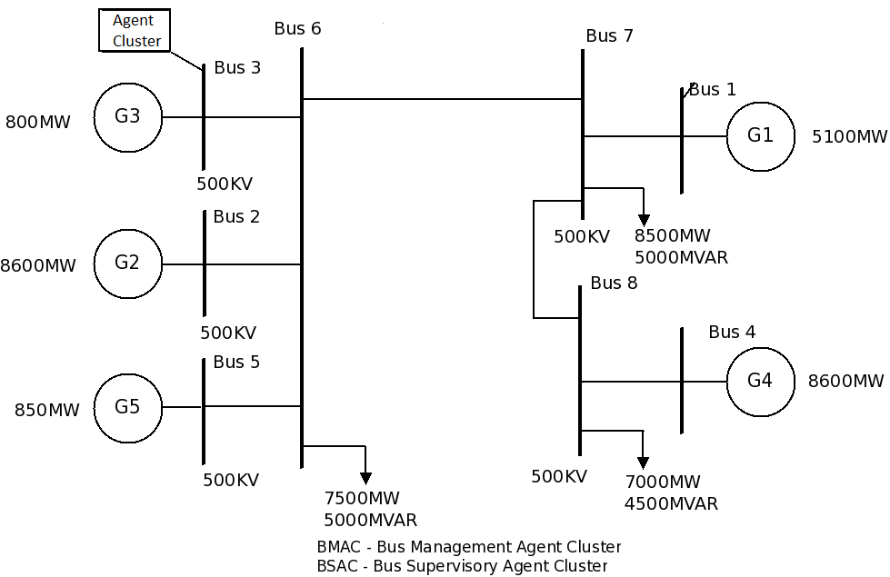
Single cluster testing
Used to test the MAM.
A single cluster is placed in generator bus 3.

Slide 41
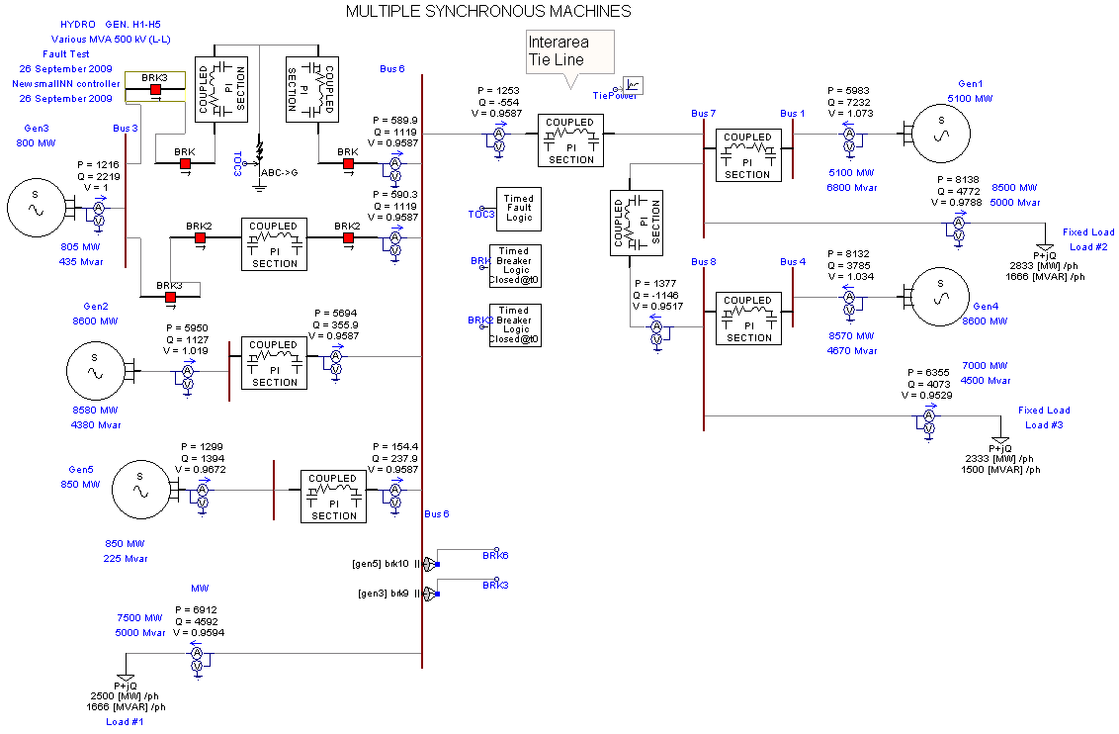
Two area model implementation in PSCAD

Slide 42
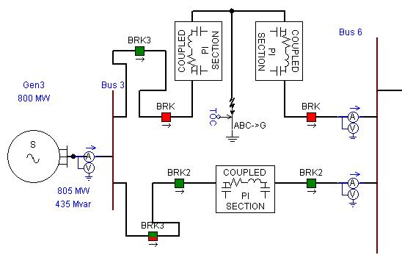
Fault simulation in generator 3
At time t=5 seconds, short circuit fault is applied for a duration of 0.1 seconds.
At time t=5 seconds, breakers ‘BRK’ open.
At time t=10 seconds, breakers ‘BRK2’ open.
Generator speed integral changes → abnormal condition detection → shut down command issued by agent cluster → breakers ‘BRK3’ opens → generator isolated.

Slide 43
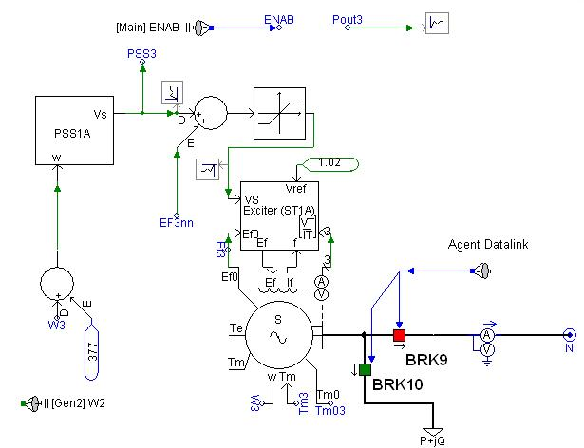
Generator 3 controller with agent interconnections
BRK9 and BRK10 are activated by agent command
BRK9 – isolates the breaker from the rest of the system
BRK10 – Includes a load (P+jQ) to the generator to bring the generator to complete stop.

Slide 44
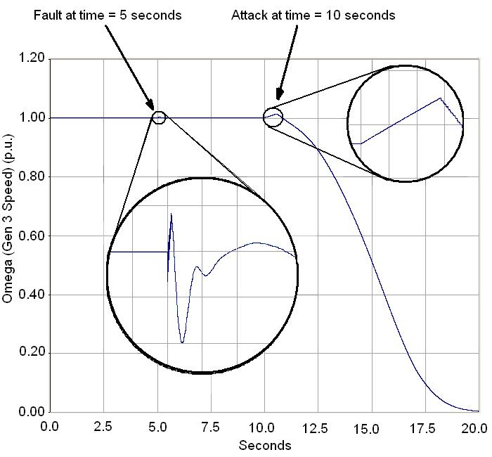
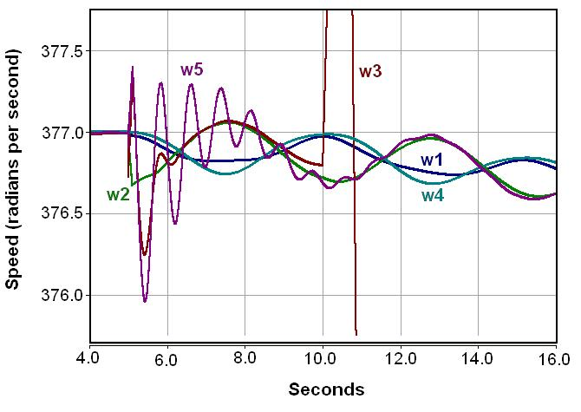
Speed deviation in generators
Speed deviation in all generators
Generator 3 speed deviation

Slide 45
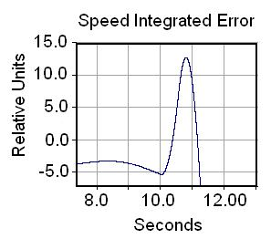
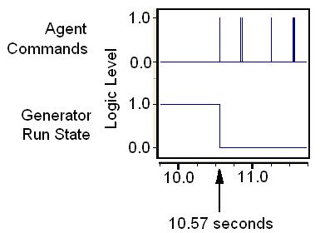
Fault identification by agent and commands to resolve fault

Slide 46
Collaborative cluster testing
Agent clusters are placed in buses.
Monitors or BMACs
In buses 1, 2, 3, 4, and 5 (on all generator buses)
Supervisors or BSACs
In buses 6 and 7 (one in each area interconnected by a tie line)

Slide 47
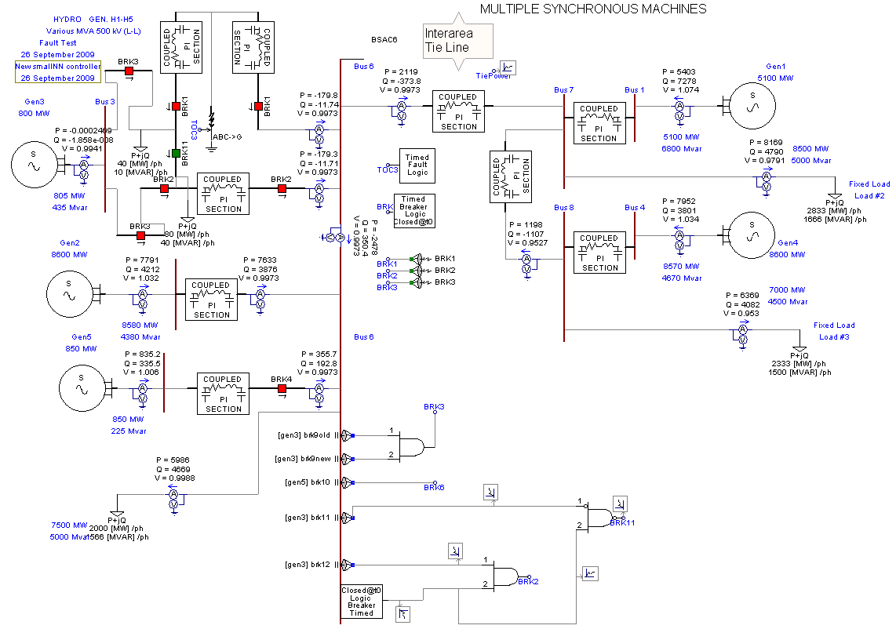
PSCAD Implementation of two-area model for collaborative agent cluster testing

Slide 48
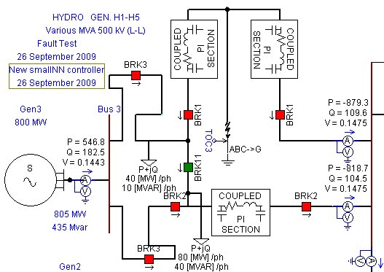
Fault simulation in generator 3
At time t=5 seconds, short circuit fault is applied for a duration of 0.1 seconds.
At time t=5 seconds, breakers ‘BRK’ open.
At time t=10 seconds, breakers ‘BRK2’ open.
Generator speed integral changes → abnormal condition detection → shut down command issued by BMAC → breakers ‘BRK3’ opens → generator isolated → area unpowered.

Slide 49
Fault simulation in generator 3
Report sent to BSAC → command issued to restore power →breakers BRK2 closed to receive power → breakers BRK11 closed to power top portion.
At time t=15 seconds breakers ‘BRK1’ closed to simulate fault restoration → reported to BSAC → BSAC issued command to include generator to system → breakers ‘BRK3’ closed to include generator → back to normal.

Slide 50
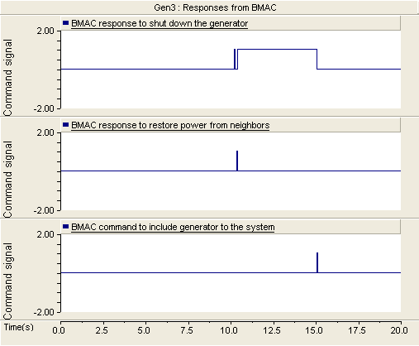
Responses from BMAC

Slide 51
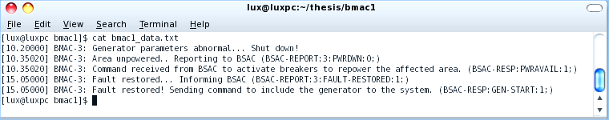
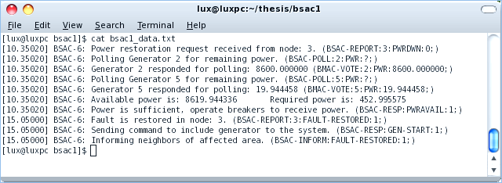
Log messages

Slide 52
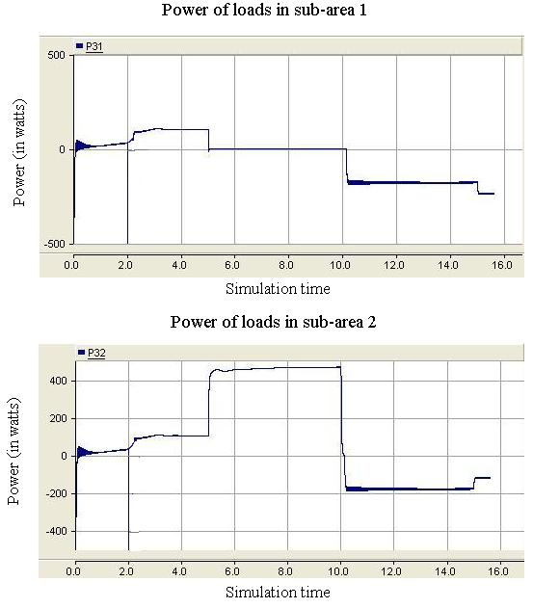
Power levels in fault area

Slide 53
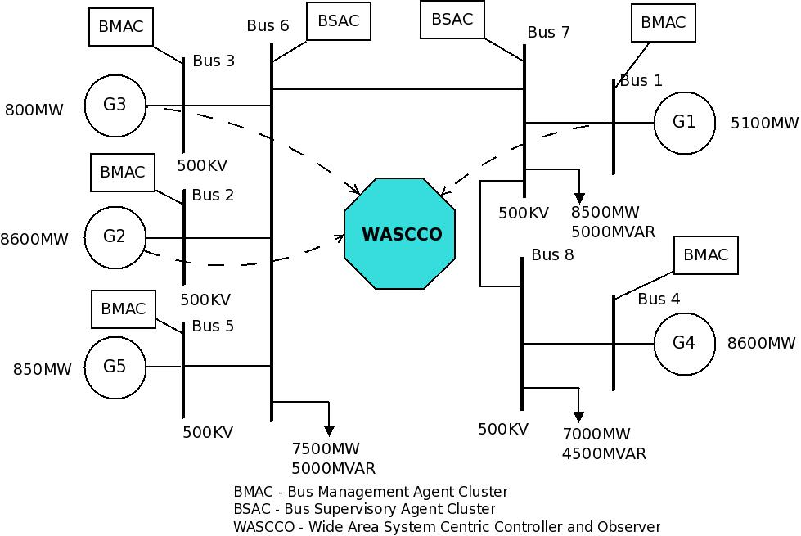
Two-area model for wide area controller testing
Generators G1, G2, and G3 are monitored by wide area controller WASCCO.

Slide 54
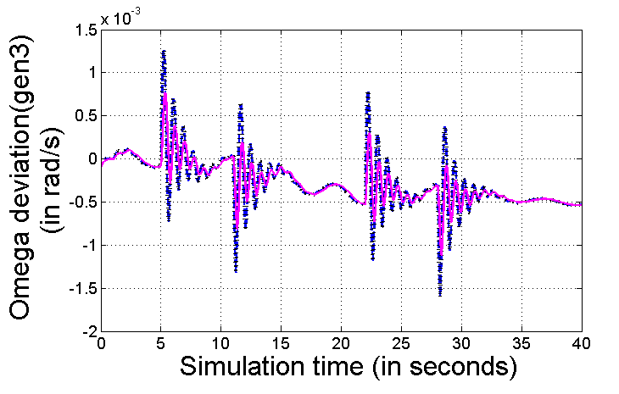
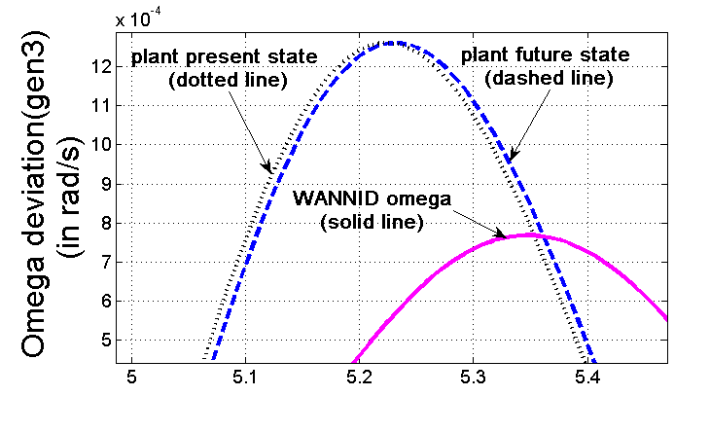
Identifier offline training - omega (after single pass)

Slide 55
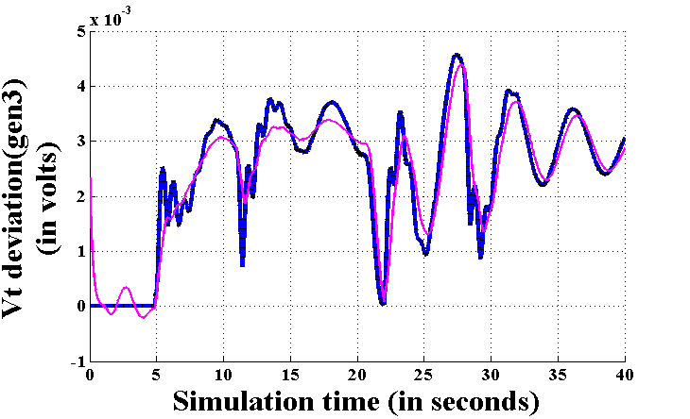
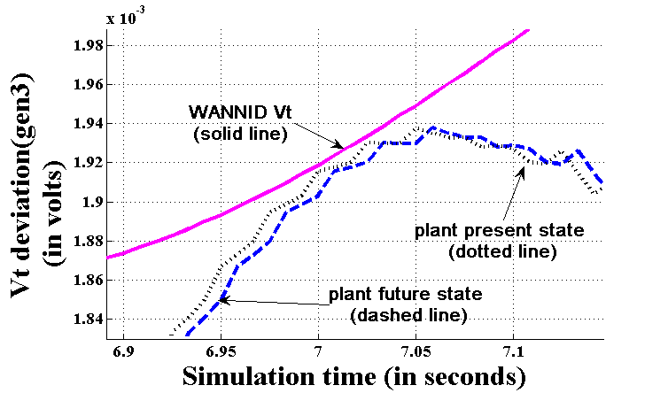
Identifier offline training – Vt (after single pass)

Slide 56
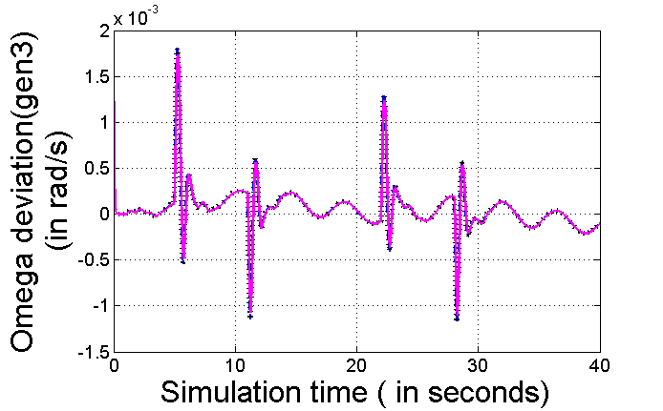
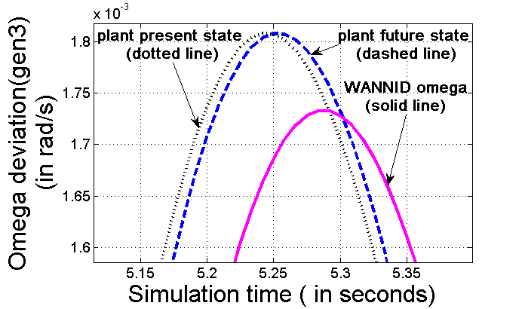
Identifier offline training - omega (after 10 passes)
Identifier predicted state is indistinguishable from plant future state

Slide 57
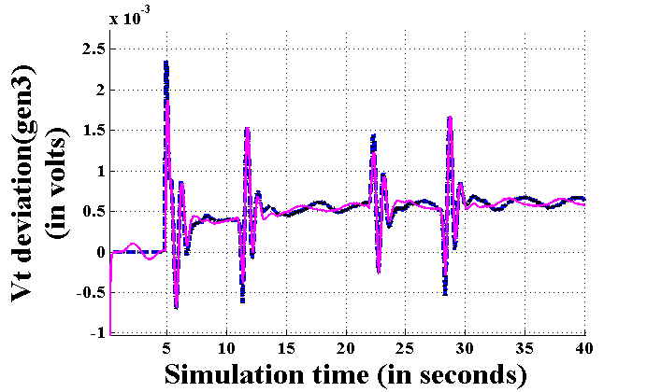
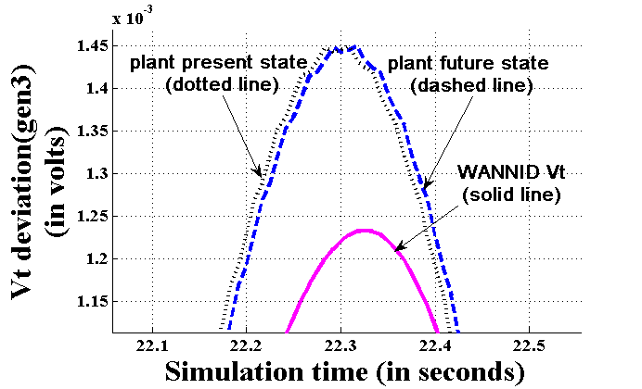
Identifier offline training – Vt (after 10 passes)
Identifier predicted state is indistinguishable from plant future state

Slide 58
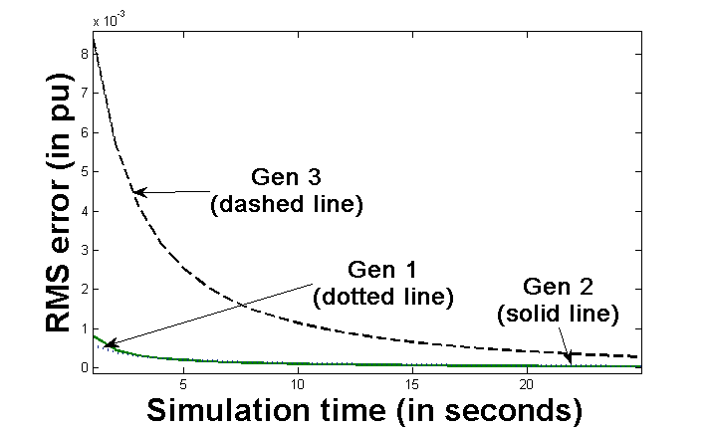
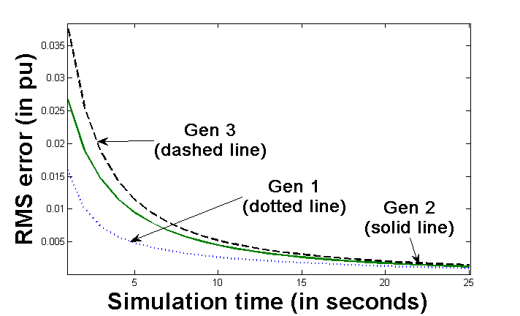
Identifier RMS error (offline)
Omega
Vt
RMS error gets reduced at the end of each pass
and stabilizes after 20 passes

Slide 59
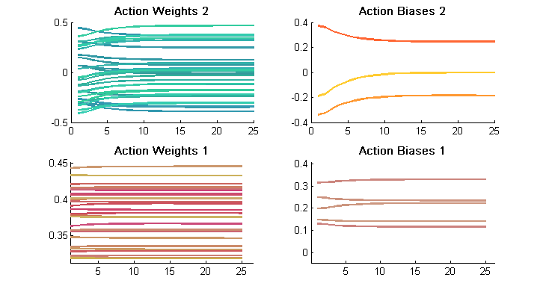

Action weights and biases and RMS error (offline)

Slide 60



Critic weights and biases and RMS error (offline)
RMS error for future lambda 1
RMS error for future lambda 2

Slide 61
Identifier online training - omega
Close to last pass of offline training. Identifier learned well.

Slide 62
Identifier offline training - Vt
Close to last pass of offline training. Identifier learned well.

Slide 63


Identifier error during online training

Slide 64




Changes in weights and biases for Identifier during online training

Slide 65


Action online training
Action error
Weights and biases

Slide 66


Critic online training
Critic error
Weights and biases

Slide 67

PSCAD Implementation Main page

Slide 68

Sub-page for Wide area controller
Inputs
Omega
Vt
applied control signal
Outputs
Normalized omega
Normalized Vt
Control signal

Slide 69

Generator 3 sub-page - Torque disturbance test
Torque disturbance is given to the applied torque in 4 different time periods
0.2 p.u increase at t0=5 seconds.
0.2 p.u decrease at t=11 seconds.
0.2 p.u increase again at t=22 seconds.
0.2 p.u decrease again at t=28 seconds.

Slide 70
Measuring generator stability
To measure inter-area stability, difference in rotor speed variations between generators in different areas are considered.
Omega1 minus omega3 →difference in speed deviation of generator 1 (area 2) and generator 3 (area 1)
Omega1 minus omega2
Omega1 minus omega2
Rotor speed variations are compared for no control, with power system stabilizer, and developed wide area controller.

Slide 71

Performance comparison
Works well… But could be improved.

Slide 72
Controller enhancement
Controller fine tuning is done based on the following activities
Normalization of action input.
Change in the number of hidden neurons for action network.
Feeding plant future state identified by the model identifier to the action network.
Same test is conducted again with the new configuration and the results are compared.

Slide 73

Performance comparison with enhanced controller.
No visible deviation after the initial peek.

Slide 74

Performance comparison with enhanced controller.

Slide 75

Fault simulation testing
Short circuit fault is applied at t=5 seconds for a duration of 0.1 seconds.
Breakers labeled ‘BRK’ opens at t=5 seconds and closes at t=15 seconds.

Slide 76

Performance comparison for fault simulation test
Better than PSS and less rotor speed deviation.
Application of fault

Slide 77

Performance comparison for fault simulation test

Slide 78
Conclusions
The proposed FIPA-compliant multi-agent systems are able to protect the system components during abnormal conditions.
Communication mechanisms between agent clusters provide immediate fault restoration.
In a two-area power system model, developed wide area controller could provide better system stability with a global view of the model.
The power system generators recovered from disturbances and faults more quickly and with less deviation of rotor speed.
Wide area controller performed better than local controllers.

Slide 79
Future Work
Hardware implementation for Monitoring/Resurrection agent.
Distributing agent clusters across multiple machines.
Applying developed wide area controller in a power system model with components exhibiting more dynamic behavior.

Slide 80
Questions?

